Slide 1
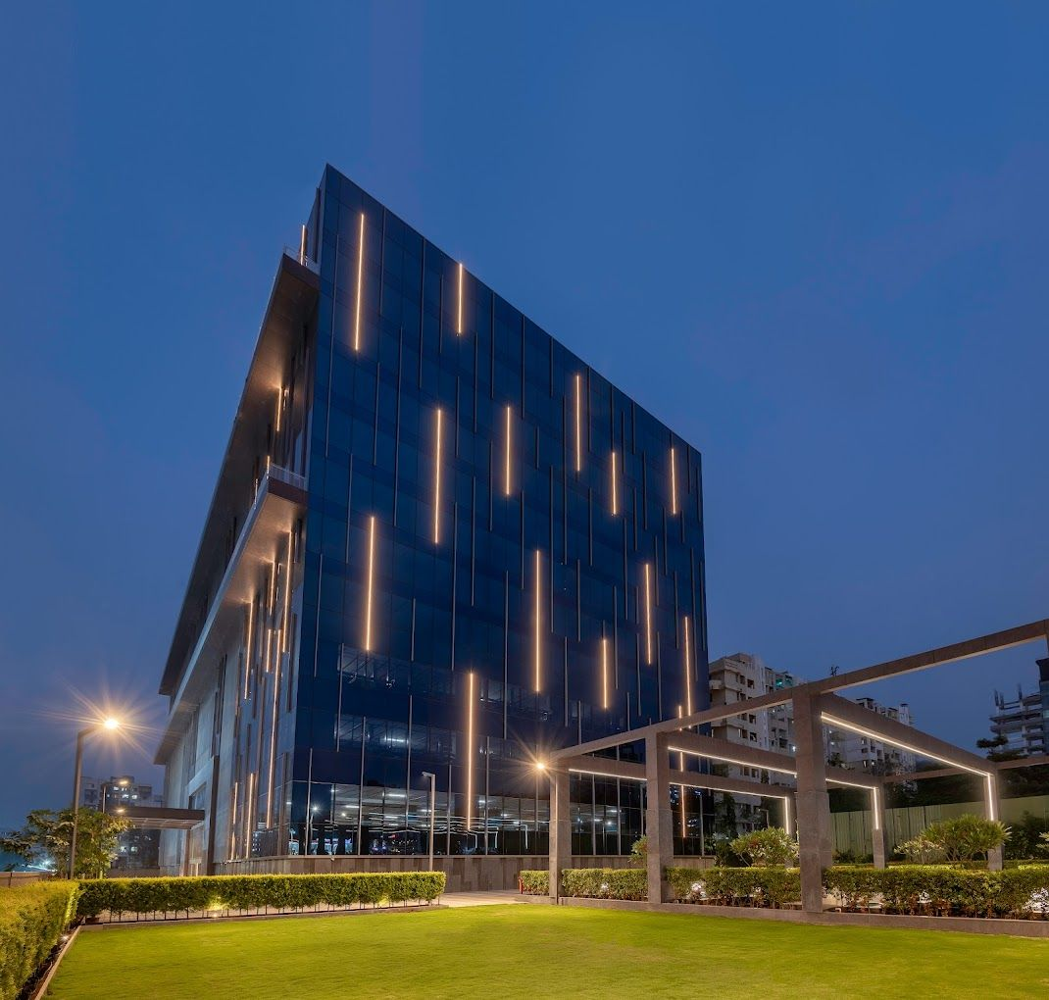




SGGSIE&T
INTERNSHIP
REPORT
BHUPESH BORKAR

Slide 2




DESIGNED BY
BHUPESH MILIND BORKAR
REG. NO. : 2019BCS091
ROLL NO. : A 43
CLASS : FINAL YEAR CSE
PROJECT GUIDE:
Prof. P. S. NALWADE

Slide 3

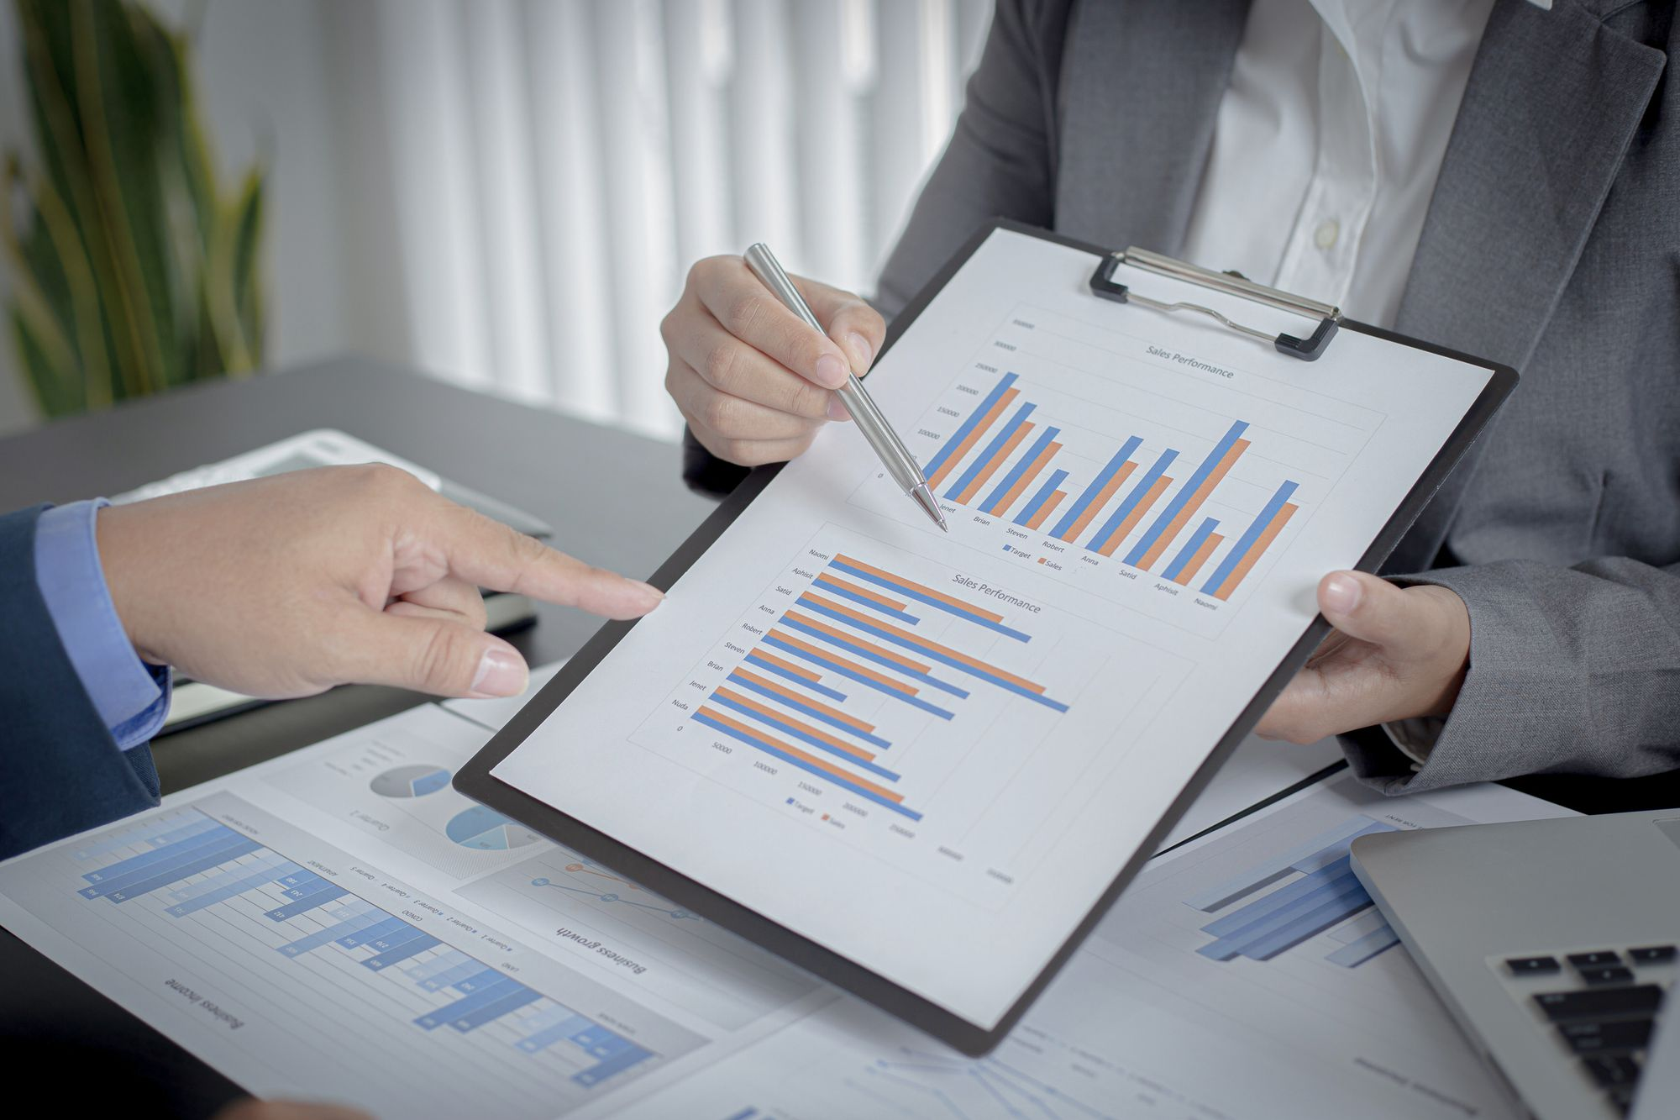

TABLE OF CONTENTS
Internship Details
Introduction to IOT
IOT Advantages & Disadvantages
Technologies
Introduction to PTC ThingWorx
Data Processing in ThingWorx
Data Modelling in ThingWorx
Project 1 - Car Dashboard
Project 2 - Boiler Plant Monitoring
Project 3 - Gym Dashboard
Conclusion

Slide 4



INTERNSHIP DETAILS
01
1
COMPANY NAME : ITHENA Technologies Pvt. Ltd
02
INTERNSHIP DURATION : 2nd Jan, 2023 - 30th Jun, 2023.
2
03
3
DOMAIN : IOT Application Development.

Slide 5
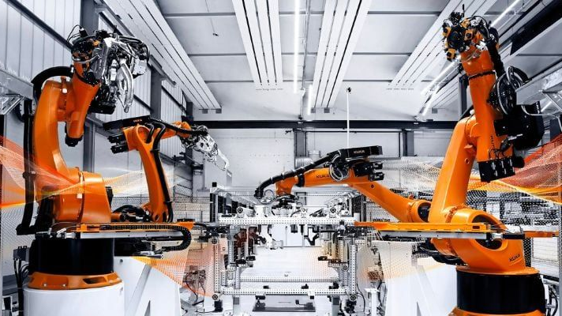
INTRODUCTION TO IOT
Internet of Things
The Internet of Things is the idea of everyday objects like light bulbs and thermostats being connected to the Internet, enabling us to communicate with devices.
Over the past few years, IoT has become one of the most important technologies of the 21st century. Now that we can connect everyday objects — kitchen appliances, cars, thermostats, baby monitors — to the internet via embedded devices, seamless communication is possible between people, processes, and things.

Slide 6
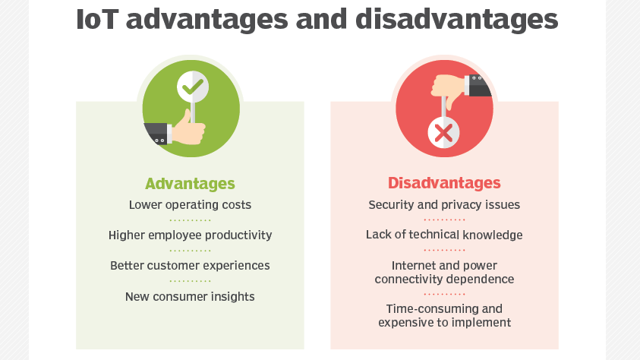

Slide 7
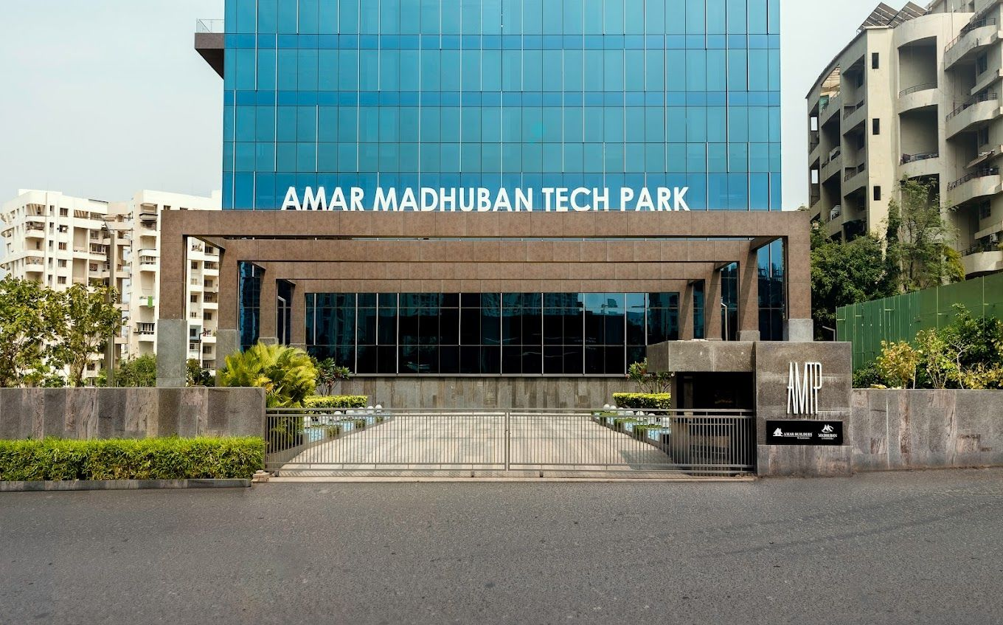



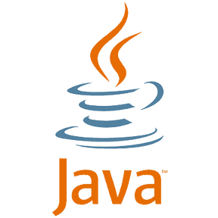

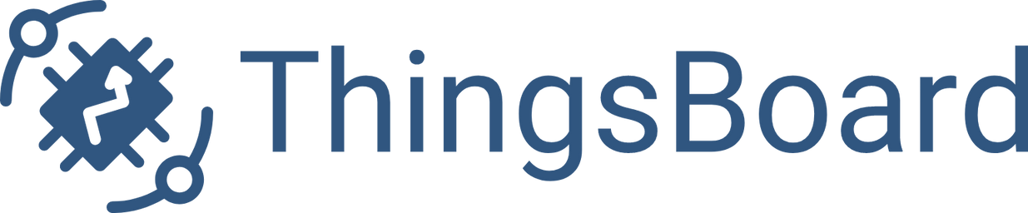
TECHNOLIGIES

Slide 8
INTRODUCTION TO PTC THINGWORX
I am currently a part of the IoT department, where I work as an intern specializing in ThingWorx development. There are different platforms used for IoT application development, one of which is ThingWorx.
PTC ThingWorx is an industrial Internet of Things (IoT) platform developed by PTC, a leading technology company. It is designed to enable the rapid development, deployment, and management of IoT applications and solutions.
ThingWorx provides a comprehensive set of tools and capabilities for building and scaling IoT applications, including connectivity to devices and sensors, data collection and storage, real-time analytics, visualization, and application development. It offers a robust set of pre-built IoT components, allowing users to quickly create IoT applications.

Slide 9
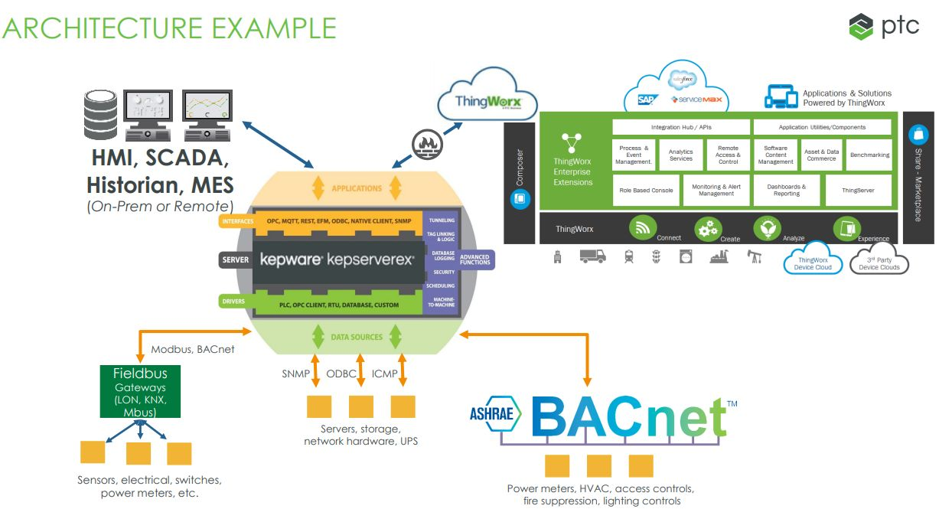
DATA PROCESSING
NEXT PROJECT
Data Processing from sensors through protocols to Kepware server and ingestion into Thingworx.

Slide 10
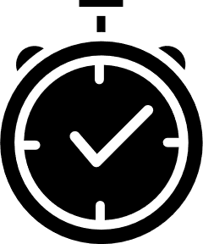


DATA PROCESSING AND ANALYSIS
Industrial plants have various sensors, devices, like temperature sensors, pressure sensors, flow meters, PLCs (Programmable Logic Controllers), SCADA (Supervisory Control and Data Acquisition) systems that collect data.
ThingWorx provides interfaces and APIs to receive and ingest data and provides visualization tools to create dashboards, charts, and graphs to present the processed data.
These visualizations help users monitor the industrial plant's performance, track key metrics, and identify anomalies or trends. Reports can also be generated based on the analyzed data. It can also generate alerts or notifications based on predefined conditions.

Slide 11
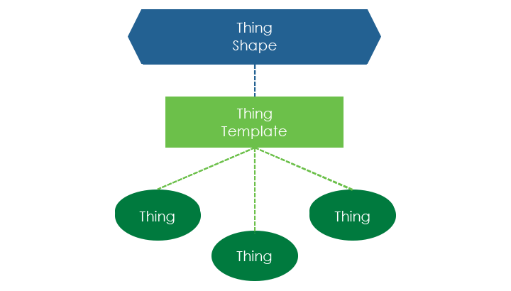
ThingWorx Foundation Data Model
THINGWORX FOUNDATION DATA MODEL
A Data Model creates a uniform representation of all items that interact with one another. Building an IoT solution in Foundation begins with defining your Data Model, the collection of Entities that represent your connected devices, business processes, and your application.
Entities are the highest-level objects created and maintained in Foundation, as explained below.

Slide 12
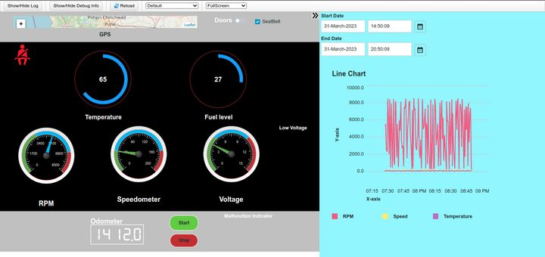
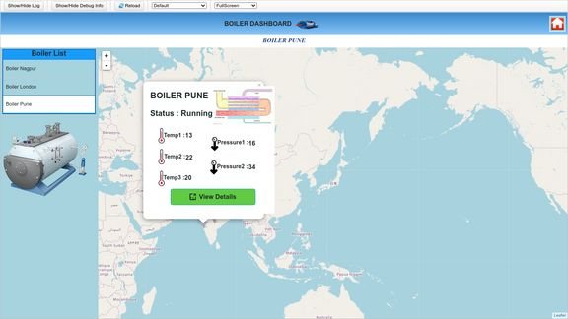
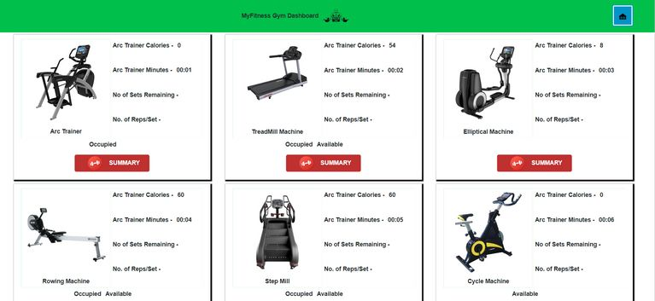
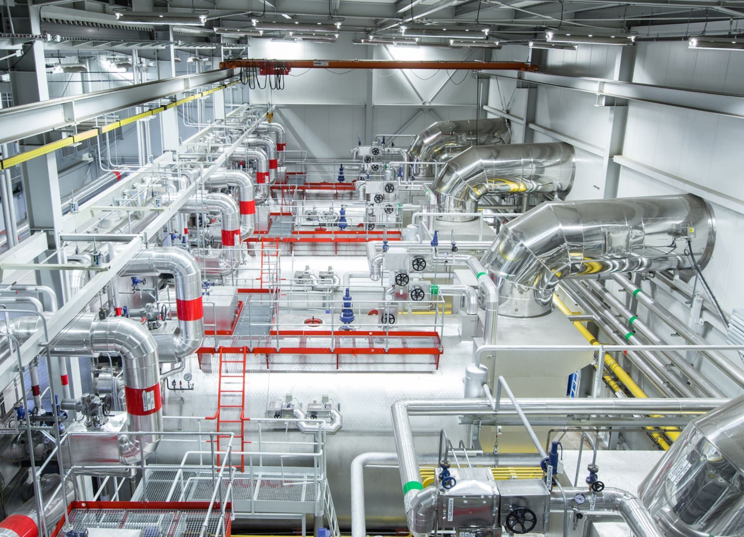
PROJECT
These are few projects that I developed during the internship period.
Project 1
Project 2
Project 3
CAR DASHBOARD
BOILER PLANT MONITORING
GYM DASHBOARD
Car dashboard is an smart connected automated IoT project built on Thingworx where users can monitor their vehicle performance, see real time data and analyze it on a webpage.
Boiler Dashboard is a smart connected factory, multiple locations connected dashboard for monitoring and maintaining three Boiler plants.
The Gym Monitoring project is an innovative system designed to track and analyze the fitness activities of individuals within a gym setting.

Slide 13
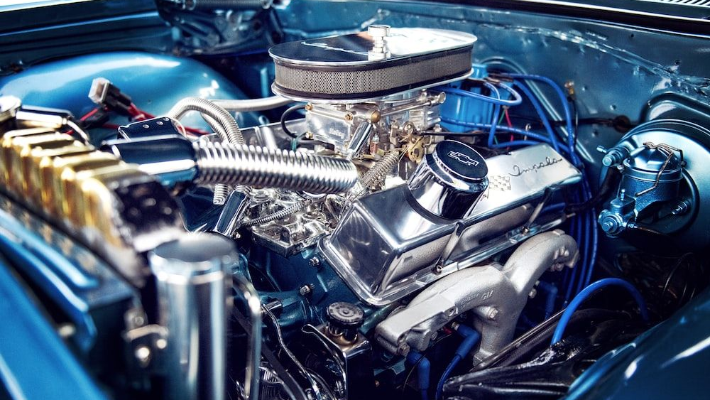
PROJECT 1 - CAR DASHBOARD
Car dashboard is an smart connected automated IoT project built on Thingworx where users can monitor their vehicle performance, see real time data and analyze it on a webpage.
The dashboard includes an RPM gauge, speedometer, fuel level indicator, voltage and temperature monitoring, allowing users to monitor the car's performance and vital parameters. With the ability to analyze data against different time stamps, users can gain valuable insights into the vehicle's behavior and diagnose any issues effectively.
GPS for location monitoring, and start-stop functionality for engine control. By combining these features, the Car Dashboard project offers a professional solution for monitoring and optimizing the performance of a vehicle, enhancing the overall driving experience and promoting efficient maintenance practices.

Slide 14
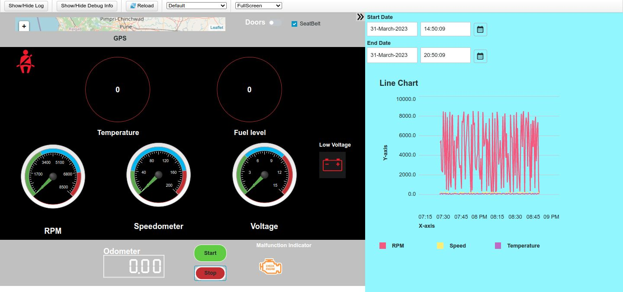
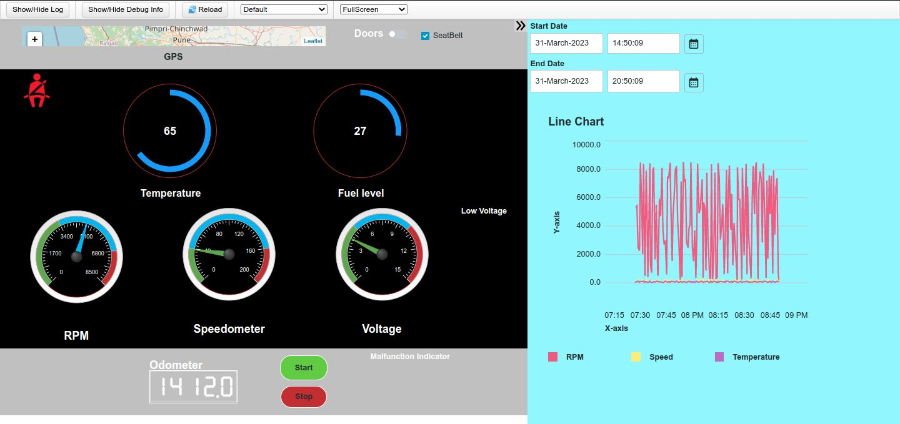
PROJECT 1 - CAR DASHBOARD
FRONTEND VIEW
READY STATE ->
<- CAR RUNNING

Slide 15
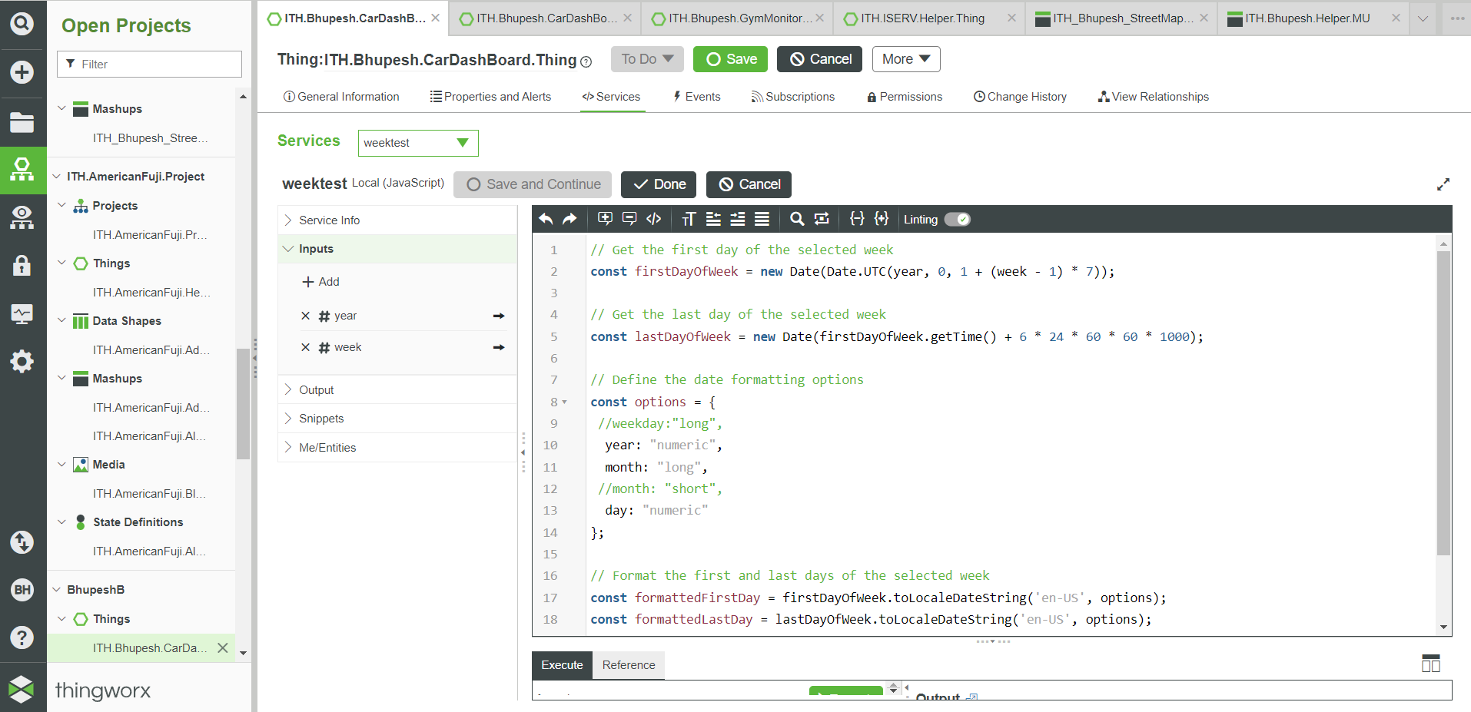
PROJECT 1 - CAR DASHBOARD
BACKEND SERVICES - THINGWORX

Slide 16
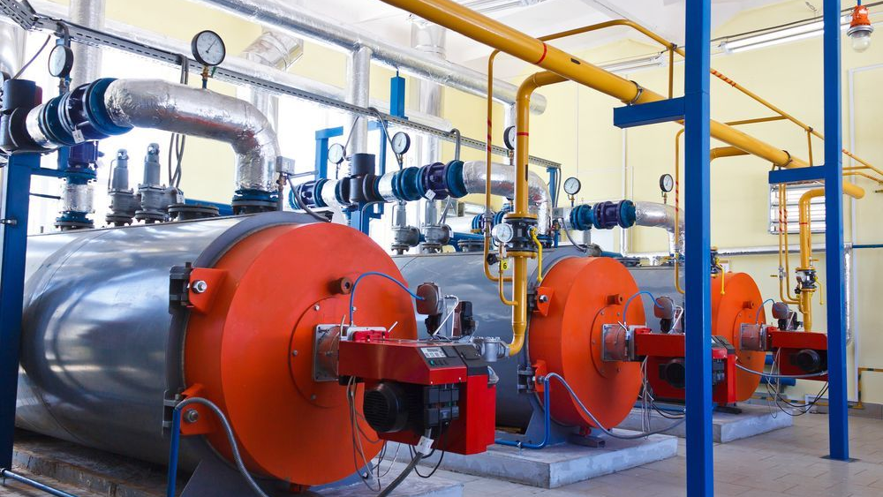
PROJECT 2 - BOILER PLANT MONITORING
Boiler Dashboard is a smart connected factory, multiple locations connected dashboard for monitoring and maintaining three Boiler plants.
The IoT application utilizes a distributed architecture, consisting of three main components: the user interface, the data collection module, and the data analysis module.
The boiler monitoring application offers the following features:
Real-time monitoring of boiler plants with location-based categorization, allowing users to keep track of each boiler's performance.
Display of various statistics and performance indicators, such as temperature, pressure, and fuel consumption, for each individual boiler.
Analysis of historical and real-time data to identify patterns, detect anomalies, and predict potential failures.

Slide 17
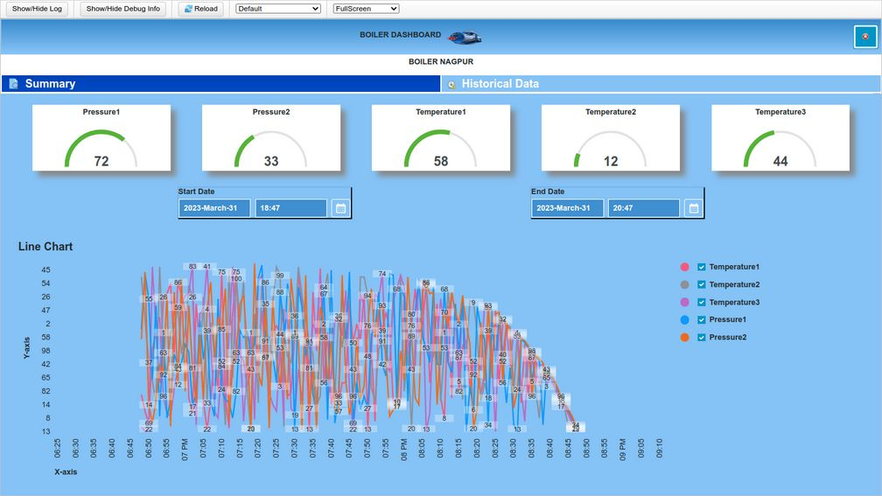
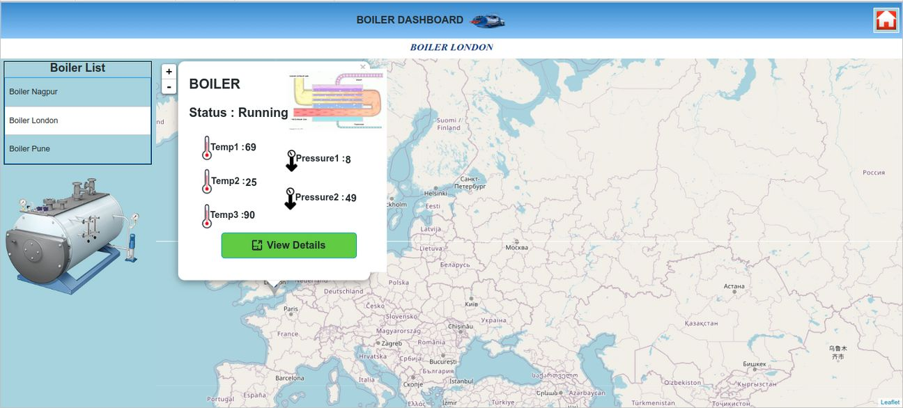
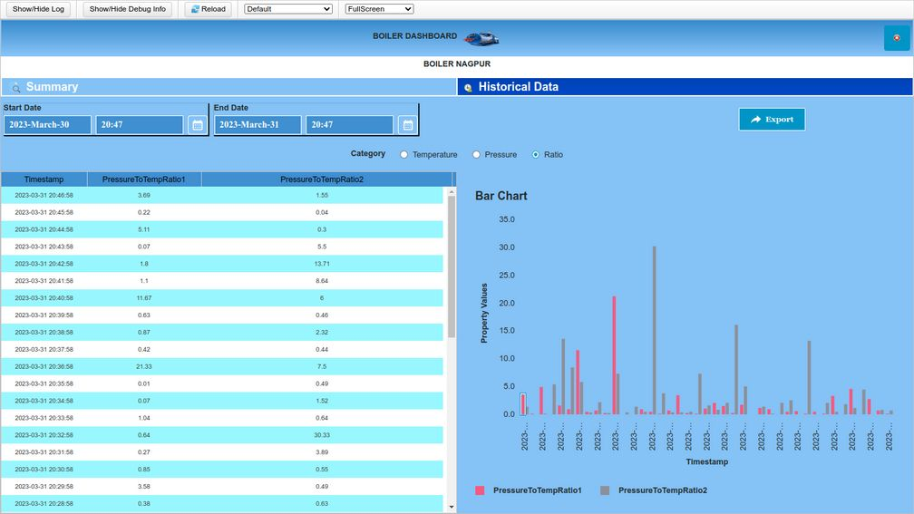
PROJECT 2 - BOILER PLANT MONITORING
FRONTEND VIEW

Slide 18
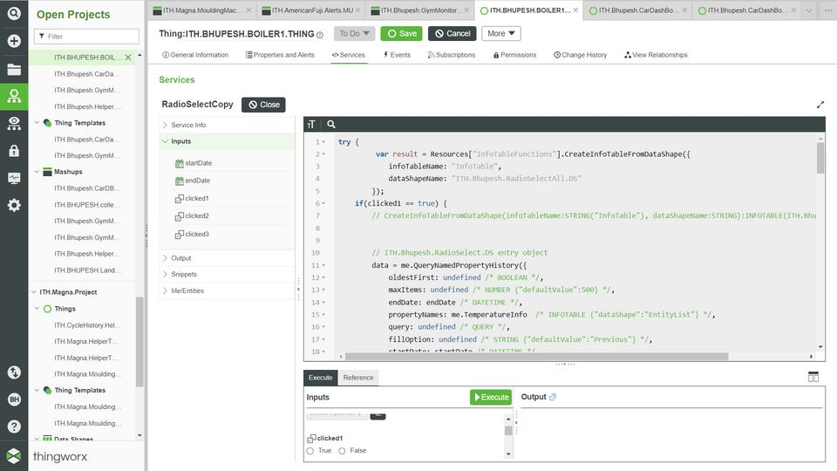
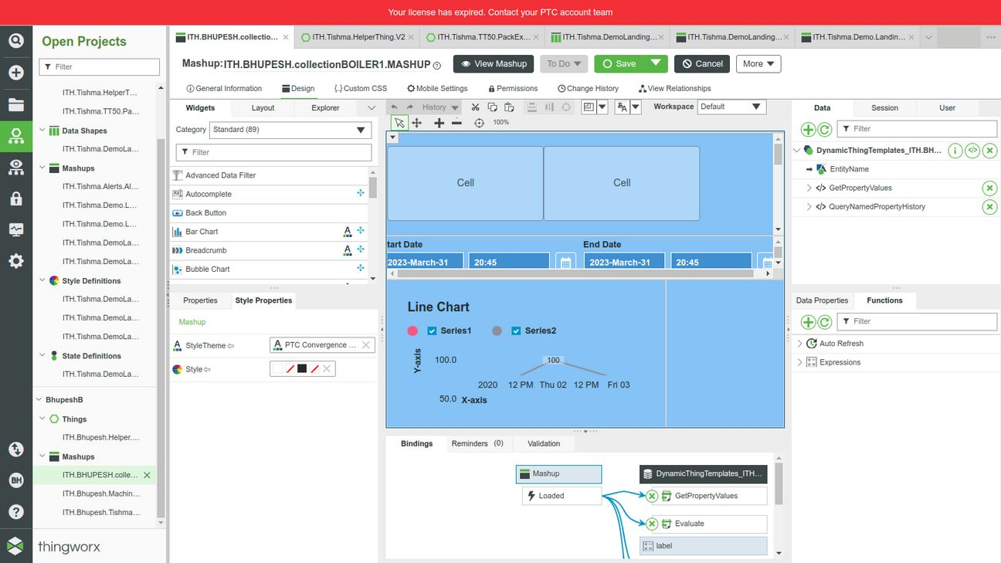
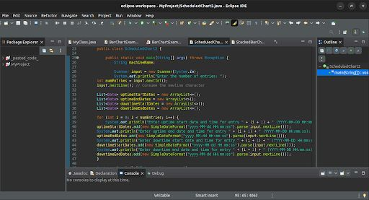
PROJECT 2 - BOILER PLANT MONITORING
BACKEND SERVICES - THINGWORX

Slide 19
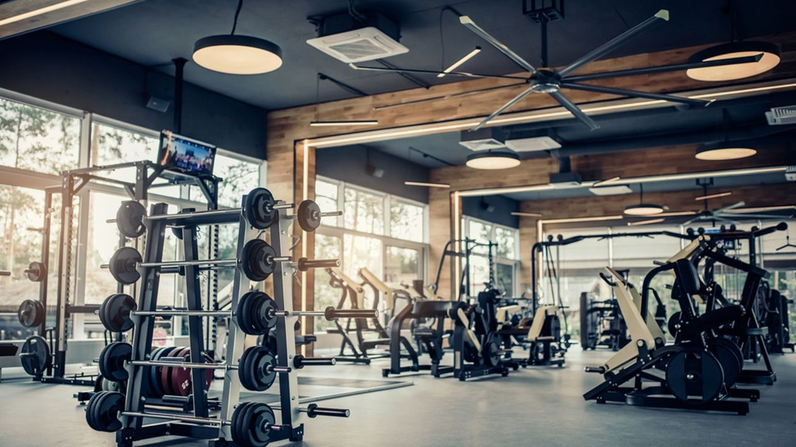
PROJECT 3 - GYM DASHBOARD
The Gym Monitoring project is an innovative system designed to track and analyze the fitness activities of individuals within a gym setting. The project encompasses two main components: personal fitness monitoring and gym machine interface.
Gym Monitoring project offers a holistic solution for both individuals and gym administrators. It empowers users to monitor their personal fitness levels, set targets, and track their progress over time. Simultaneously, the gym machine interface facilitates effective resource management and allows administrators to optimize machine usage based on real-time data. By combining personal fitness monitoring, machine tracking, and performance metrics, this project enhances the gym experience, promotes accountability, and supports individuals in achieving their fitness goals.

Slide 20
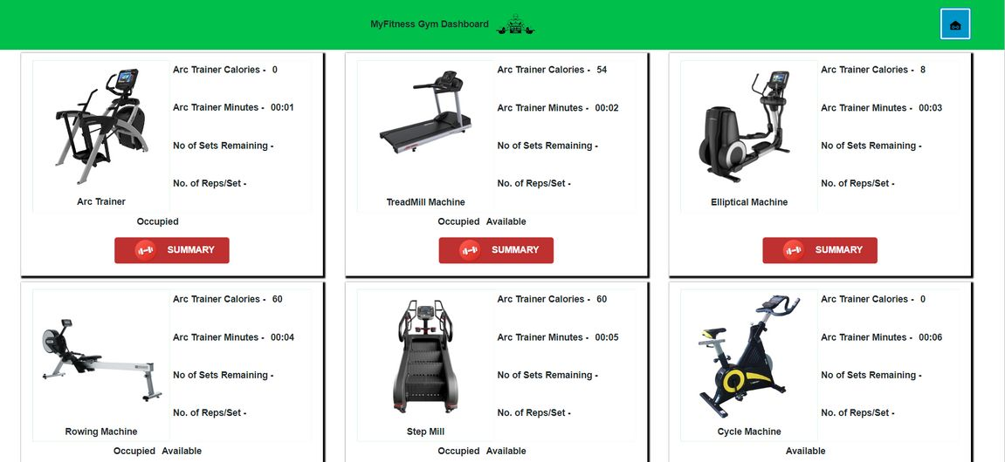
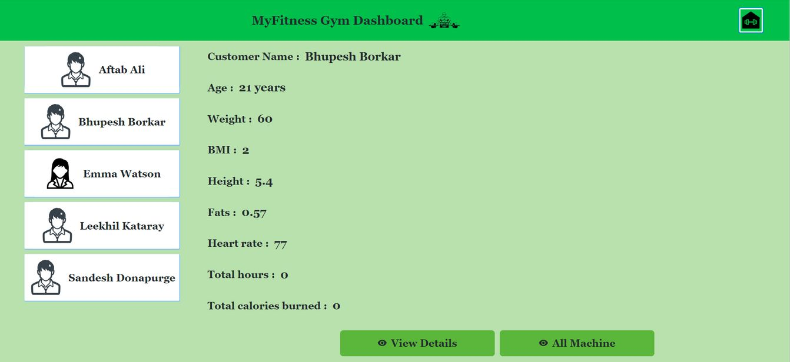
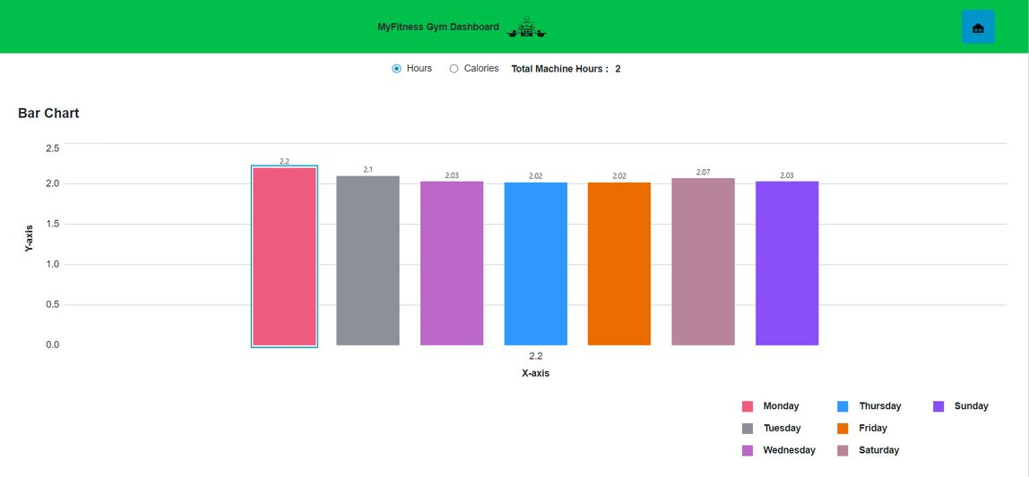
PROJECT 3 - GYM DASHBOARD
FRONTEND VIEW

Slide 21
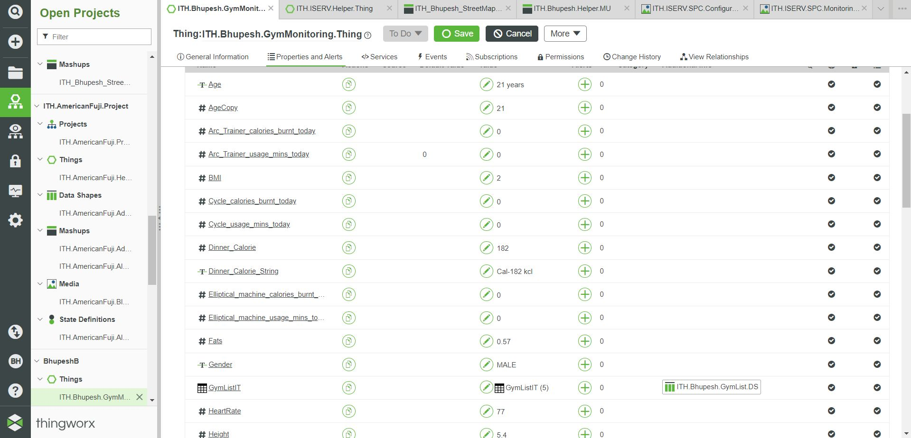
PROJECT 3 - GYM DASHBOARD
BACKEND SERVICES - THINGWORX

Slide 22
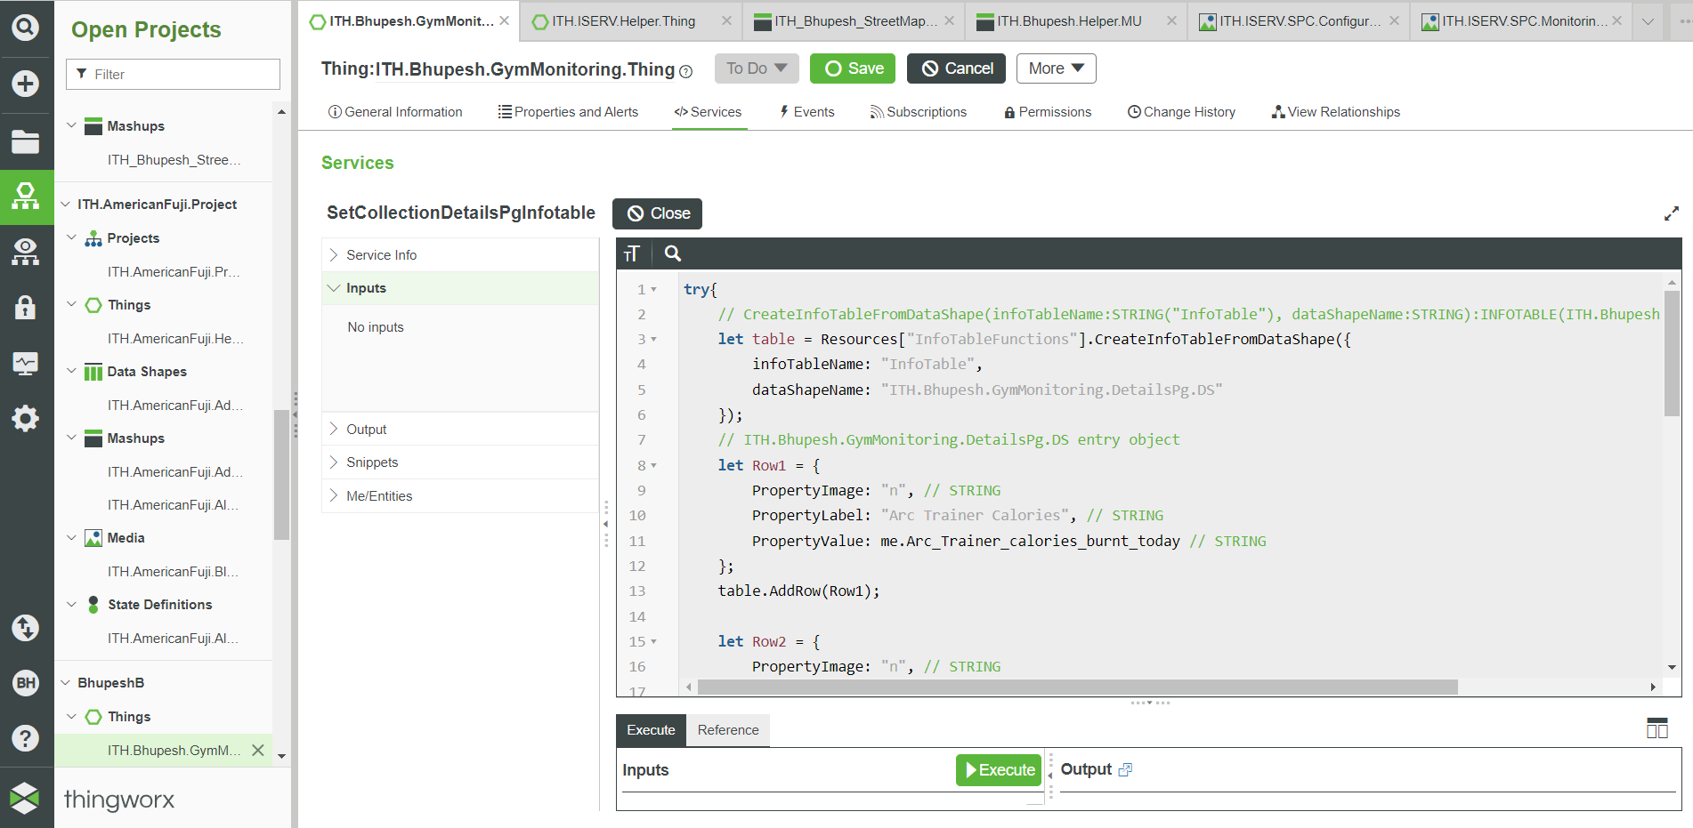
PROJECT 3 - GYM DASHBOARD
BACKEND SERVICES - THINGWORX

Slide 23
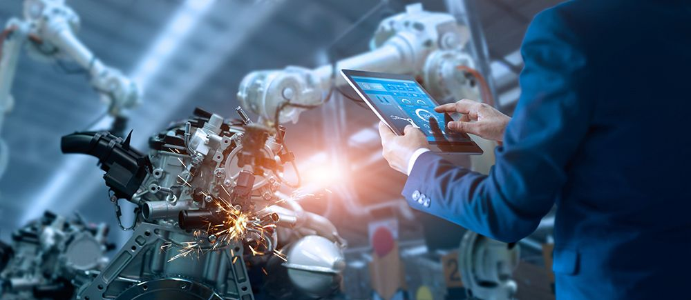
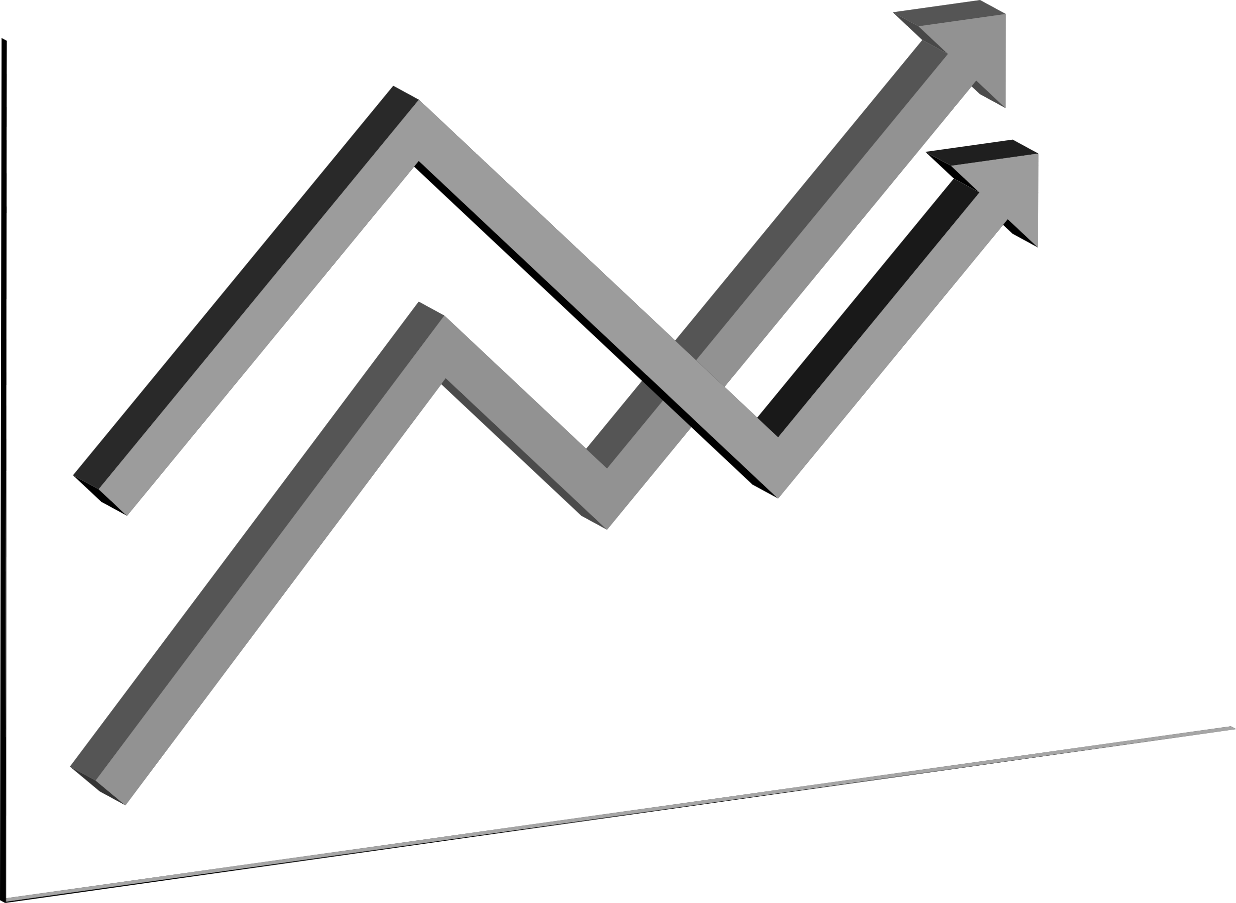
CONCLUSION
In conclusion, my internship experience at ITHENA Technologies has been valuable and rewarding. Throughout the internship, I had the opportunity to apply the knowledge and skills gained during my academic studies in a practical setting. The internship provided me with hands-on experience and exposure to real-world scenarios of IOT Application Development.
During the internship, I worked on various projects and tasks, allowing me to enhance my technical skills and gain a deeper understanding of the industry. I collaborated with professionals and colleagues, contributing to team efforts and successfully completing assigned projects. This experience also helped me develop important soft skills such as communication, teamwork, and problem-solving. I am grateful for the support and guidance provided by the organization and the college for the opportunity.

Slide 24
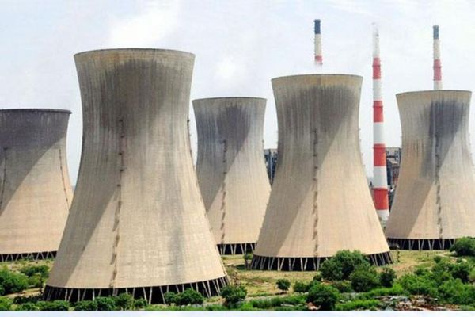
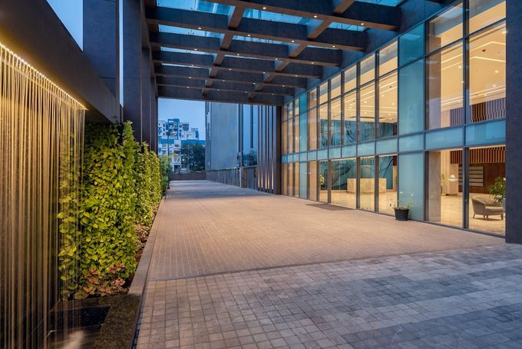
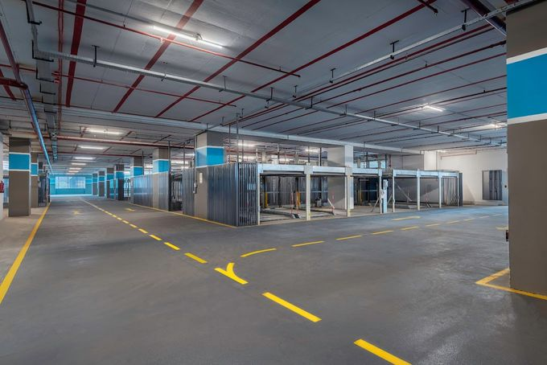
SGGSIE&T
THANK'S FOR WATCHING

